Slide 1
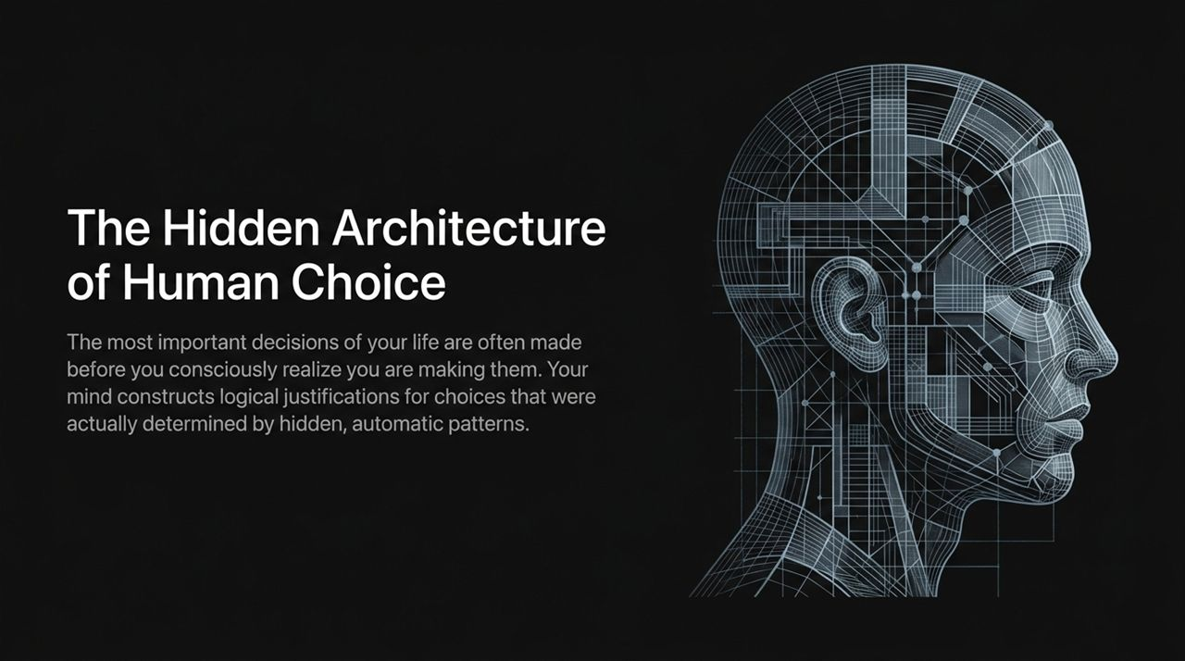
Notes:
Opening & Hook:
"Welcome, everyone. Look at the title on the screen behind me: The Hidden Architecture of Human Choice. We like to believe that we are the captains of our soul and the deliberate authors of our decisions. When you decide to accept a job offer, buy a home, or make a strategic investment, you feel like you gathered the data, weighed the risks, and made a calculated choice. But modern cognitive science reveals a humbling truth: most of your decisions are made long before your conscious mind even registers them."
Explaining the Core Concept:
"What you experience as 'logical decision-making' is often just your brain playing the role of a PR department. The choice is determined by hidden, sub-conscious mental processes—and then your conscious mind steps in to write a plausible, highly logical press release justifying why you did it. Throughout this session, we are going to pull back the curtain on this hidden architecture."
Transition & Goal:
"By understanding these hidden mechanics, you won't just learn how decisions are made—you’ll learn how to safeguard your own choices against critical errors and systematically improve the quality of your personal and professional judgments."
https://www.youtube.com/watch?v=rlYXYCVOE_c

Slide 2
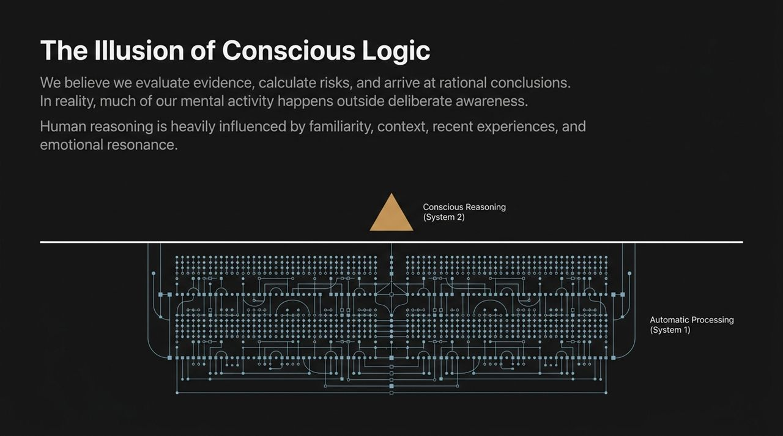
Notes:
Introducing the Two Systems:
"To understand human reasoning, Nobel laureate Daniel Kahneman introduced the framework of a dual-core mental engine: System 1 and System 2. Think of System 1 as your autopilot and System 2 as the manual operator."
Deep Dive into System 1 (Fast Thinking):
"System 1 is fast, automatic, and operates with zero conscious effort. When you instantly recognize anger on someone’s face, duck when a ball flies toward your head, or drive along a familiar route without consciously thinking about it—that is System 1 working. It thrives on pattern recognition and excels at constructing instant, plausible narratives from incomplete information. However, its primary flaw is that it constantly confuses confidence with evidence."
Deep Dive into System 2 (Slow Thinking):
"System 2, on the other hand, is analytical, deliberate, and slow. If I ask you to compute 17 times 24 in your head, your eyes dilate, your heart rate increases, and System 2 boots up. It requires high cognitive energy. System 2 is critical for evaluating risk and questioning assumptions, but it has a massive flaw: it is inherently lazy. Because deliberate thinking expends real biochemical energy, System 2 constantly looks for excuses to delegate work back to System 1."
Key Takeaway:
"The vast majority of our daily mistakes happen because System 2 rubber-stamps System 1's quick intuitive guesses without doing the actual verification work."

Slide 3
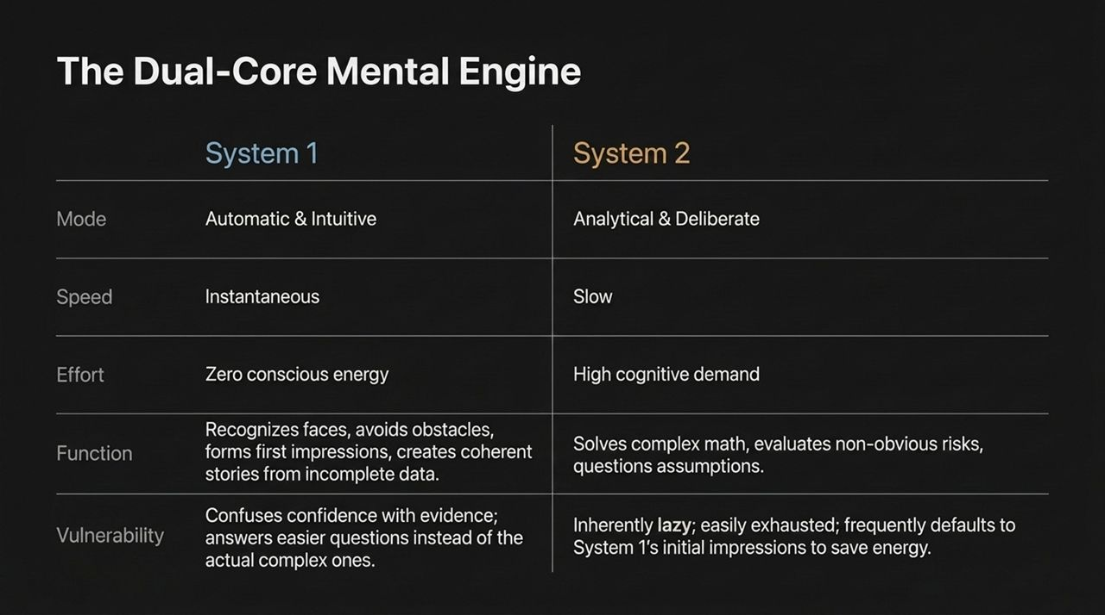
Notes:
Reframing System 1:
"Looking at the weaknesses of System 1, it’s easy to label it as 'flawed' or 'broken.' But System 1 isn't a defect—it’s an evolutionary marvel. Your brain accounts for roughly 2% of your total body weight, yet consumes over 20% of your metabolic energy. If you had to use System 2 to calculate the velocity of every footstep or deliberate over every single word you speak, you would collapse from sheer mental exhaustion before breakfast."
The Trade-off (Speed vs. Precision):
"System 1 exists to preserve energy. It relies on shortcuts to navigate routine daily life at virtually zero energy cost. Look at the gauges on the slide: System 1 operates on a whisper of fuel, while System 2 runs the needle up to 100% capacity."
The Core Problem:
"The Efficiency Paradox occurs when we use a low-energy tool for a high-stakes, high-complexity problem. When you use System 1 pattern-matching to negotiate a complex merger, write corporate strategy, or assess an investment portfolio, you are using an engine built for quick survival to perform precision engineering. That mismatch is where catastrophic judgment errors occur."

Slide 4
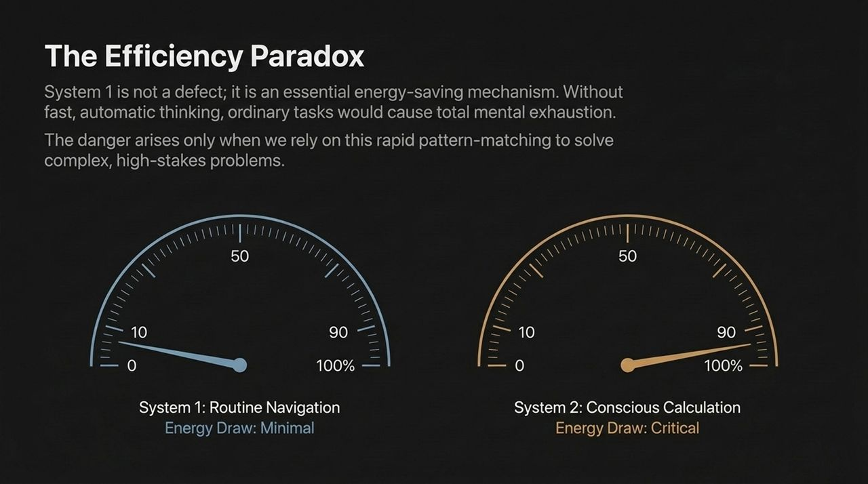
Notes:
What are Heuristics?:
"Because System 1 prioritizes speed over absolute accuracy, it relies on heuristics—mental shortcuts or rules of thumb. Think of them as software macros in the human mind. Under normal conditions, these macros work remarkably well. But in modern, high-complexity environments, they create systematic, repeatable, and predictable glitches in human judgment."
Overview of the 4 Cognitive Glitches:
"Over the next few slides, we will break down the four major categories of these cognitive glitches shown on the diagram:
Contextual Framing: How the environment surrounding a choice distorts its perceived value.
Risk Asymmetry: How our fear of loss completely overrides our desire for gain.
Statistical Blindness: Our tendency to ignore real-world probabilities in favor of vivid stories.
The Illusion of Understanding: Our habit of manufacturing neat, logical explanations after the fact to make an unpredictable world feel controllable."
Transition:
"Let’s explore these glitches one by one so you can start spotting them in your day-to-day decisions."

Slide 5
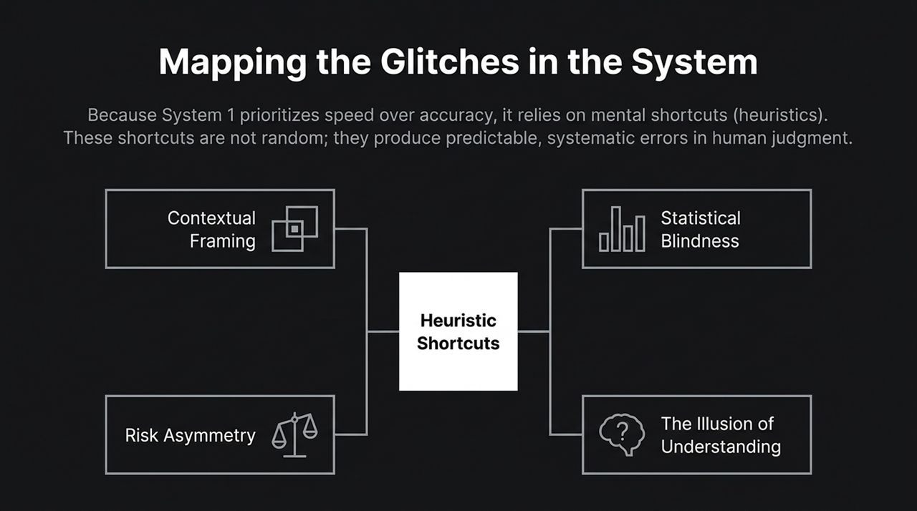
Notes:
Explaining Anchoring:
"Human minds are awful at evaluating absolute value in a vacuum. Instead, we rely entirely on comparison. Anchoring occurs when an initial piece of information acts as an unshakeable reference point for all subsequent estimations."
Real-World Example of Anchoring:
"In classic behavioral studies, if you ask people whether the height of a redwood tree is greater or less than 1,200 feet, and then ask them to guess the exact height, their guesses cluster around 800 to 1,000 feet. If you ask another group if the tree is greater or less than 180 feet, their average guess drops to around 200 feet. The first number mentioned anchors the brain, pulling conscious reasoning toward it regardless of relevance. Salary negotiations, real estate listings, and initial price quotes all rely heavily on this exact mechanism."
Explaining Framing:
"Next is Framing. Consider two products on a supermarket shelf: One says '90% Fat-Free', and the other says 'Contains 10% Fat'. Mathematically, they are identical. Psychologically, they trigger entirely different neural pathways. '90% Fat-Free' signals health and reward; '10% Fat' signals contamination and risk. Your System 1 reacts instantly to the emotional framing long before System 2 realizes the numerical reality is identical."
Practical Takeaway:
"Whenever someone presents you with an option or a figure, ask yourself: Is this an absolute value, or am I being anchored and framed by how the choice was delivered?"

Slide 6
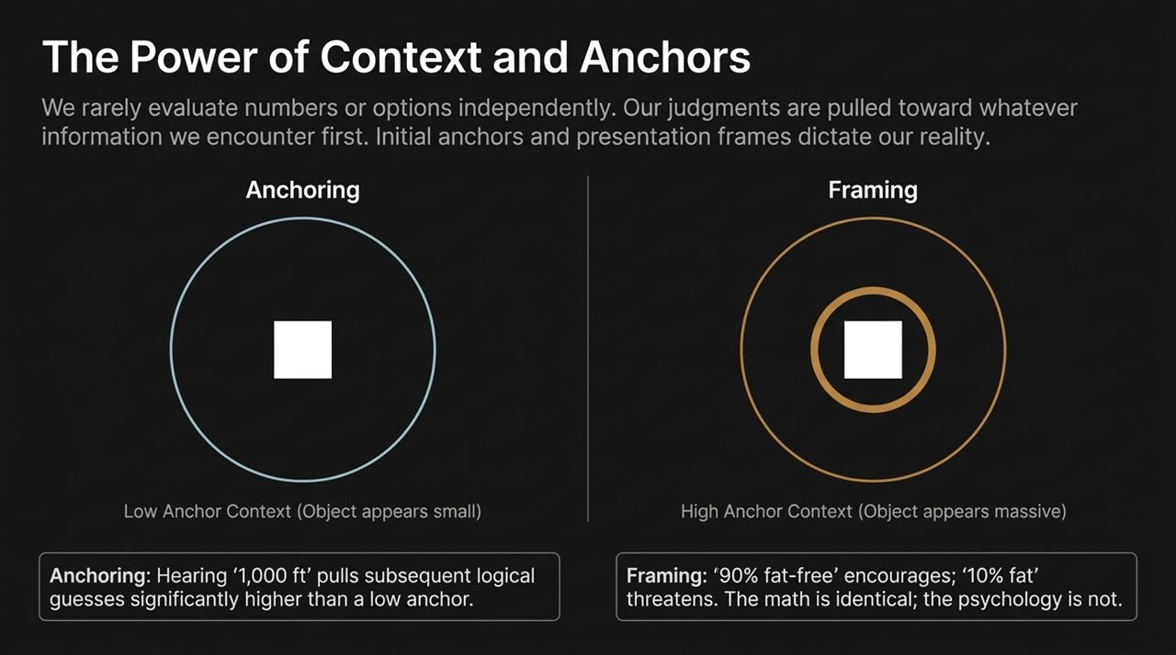
Notes:
The Availability Heuristic:
"Look at the visual on this slide: a massive, bright sphere overwhelming a quiet background grid. This illustrates The Availability Trap. When System 1 estimates how probable an event is, it doesn't look at statistical databases—it measures how easily an example comes to mind."
Availability Examples:
"If a dramatic plane crash is broadcast on the news, that vivid, emotionally charged image is instantly accessible in your memory. As a result, people suddenly feel that flying is dangerous, even though statistically, driving to the airport is exponentially more hazardous. Highly emotional, dramatic, or recent events hijack our risk assessment while quiet base rates and background statistics are completely ignored."
The Representativeness Trap:
"We see a similar glitch in Representativeness. Imagine you meet a shy, detail-oriented person who loves quiet places and reading. Is this person more likely to be a librarian or a retail salesperson? Most people instantly say 'librarian' because the description fits our prototype of a librarian. But statistically, there are vastly more retail salespeople than librarians in the population! We routinely substitute stereotypical visual matching for base-rate statistical likelihood."
Key Lesson:
"Data without a narrative is often ignored, while a vivid story without data can drive major organizational strategy into a wall. Always check the quiet statistics behind the loud story."

Slide 7
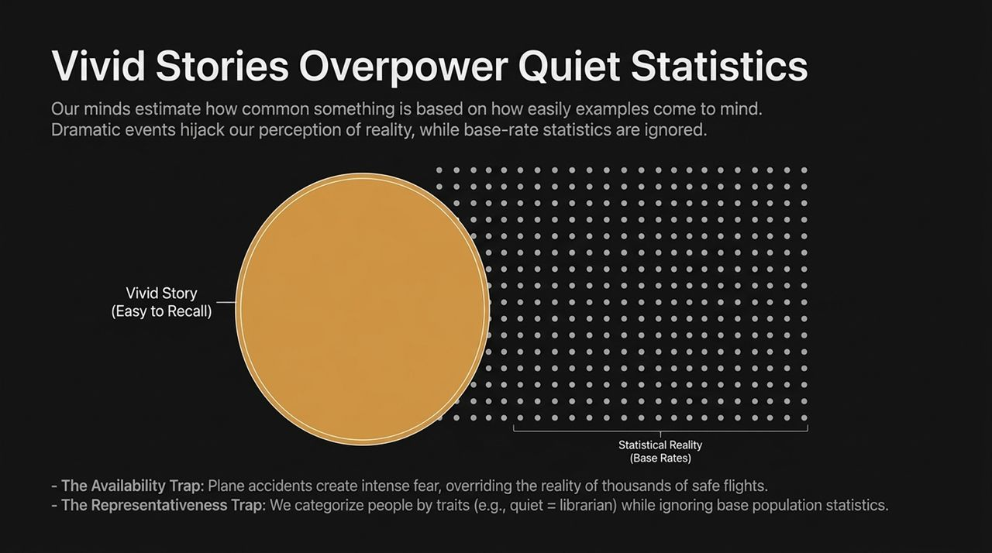
Notes:
Introduction to Loss Aversion:
"If I offer you a coin flip—heads you win $100, tails you lose $100—would you take it? Most people refuse. Mathematically, the expected value is neutral. Psychologically, however, it is a terrible deal."
Analyzing the Asymmetry Curve:
"This curve illustrates Prospect Theory, pioneered by Kahneman and Amos Tversky. Notice how steep the red line is on the loss side compared to the shallow blue line on the gain side. Empirical studies show that losses loom roughly twice as large as equivalent gains. The psychological sting of losing $100 requires a gain of around $200 just to balance the emotional scales."
Real-World Organizational Impact:
"This extreme asymmetry causes profound distortion in leadership and decision-making:
Risk Aversion: Companies routinely pass up high-probability growth opportunities because the threat of a small, visible loss triggers intense panic.
Status Quo Bias: We hold onto underperforming assets, legacy tools, or failing strategies simply because cutting our losses feels like an unbearable admission of defeat."
Practical Application:
"To make rational decisions, you must decouple the mathematical valuation from the immediate emotional threat of loss."

Slide 8
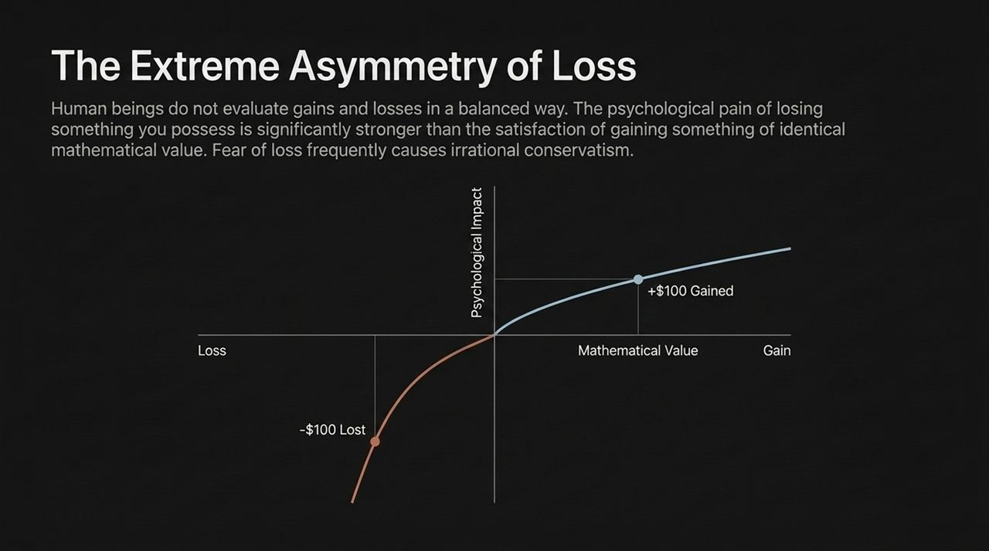
Notes:
The Fog of War vs. Hindsight:
"Look at the left side of this slide: chaos, noise, overlapping possibilities—that is the actual reality of navigating the future. Now look at the right side: a clean, straight line once the outcome is known. This is Hindsight Bias—our irresistible urge to rewrite history."
The Narrative Fallacy:
"Once an event occurs—a stock market crash, a product failure, an unexpected election result—System 1 immediately rewrites our memory of what we knew before the event. We say things like, 'I knew it all along,' or 'It was obvious that startup was going to fail.' We construct neat, linear narratives that transform chaotic randomness into predictable events."
The Hidden Danger of Overconfidence:
"Why is this dangerous? Because if you believe the past was easy to predict, you naturally conclude that the future is equally easy to predict. This creates a false sense of security and severe overconfidence in strategic forecasting. We judge past choices based entirely on their final outcome rather than the quality of the decisions made in the midst of uncertainty."

Slide 9
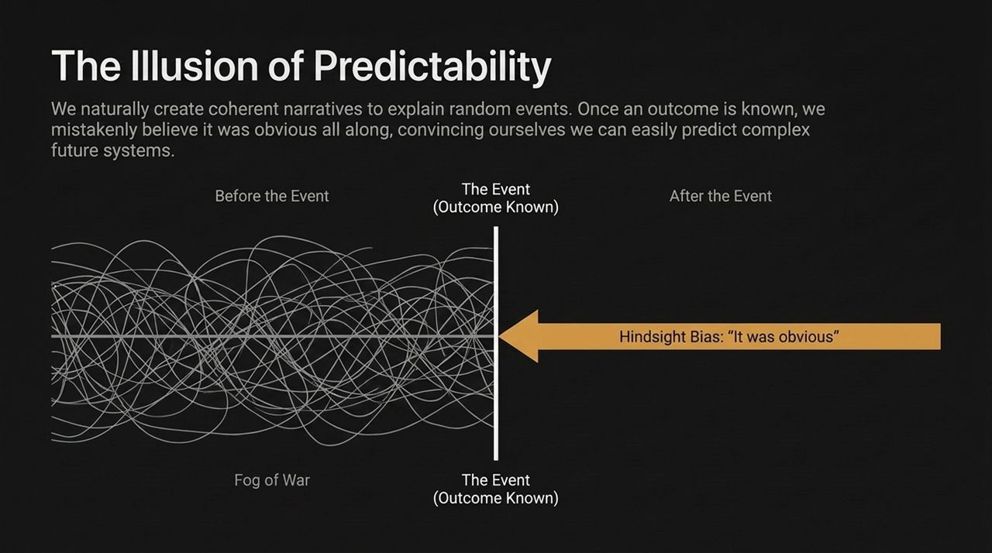
Notes:
Introduction to Sunk Costs:
"How many times have you stayed in a bad movie at the theater just because you paid $15 for the ticket? Or continued funding a doomed software project because you’ve already invested two years and millions of dollars into it? This is the Sunk Cost Fallacy."
Breaking Down Sunk Costs:
"Rational decision-making dictates that past investments are entirely unrecoverable and should have zero weight on future choices. The only question that matters today is: 'Given where we stand right now, will investing one more dollar or hour yield a positive return moving forward?' Yet, because admitting loss causes psychological pain (as we saw with Loss Aversion), we throw good money after bad, holding ourselves hostage to the past."
The Endowment Effect:
"Closely tied to this is the Endowment Effect. The simple act of owning something—a house, a project, a job title, an idea—instantly inflates its value in our mind. Studies show that sellers routinely demand significantly higher prices to part with an object than buyers are willing to pay to acquire the exact same object. We overvalue what is ours simply because it is tied to our identity."
Executive Takeaway:
"To make clear-headed forward choices, you must relentlessly sever present choices from past unrecoverable investments."

Slide 10
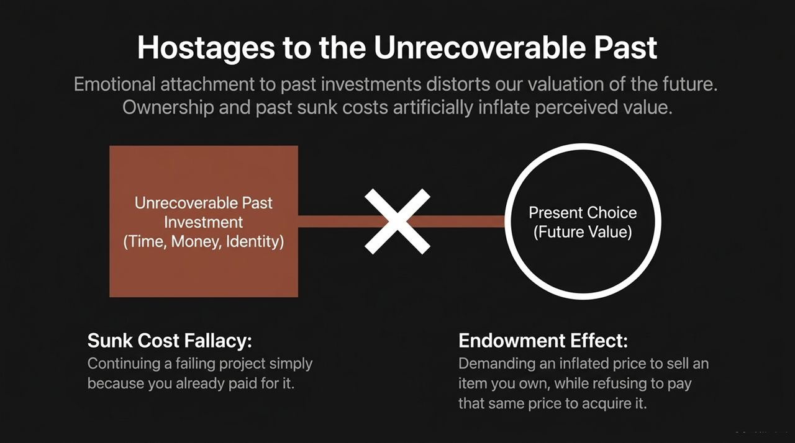
Notes:
The Assembly Line Metaphor:
"Errors in human judgment are rarely born from stupidity or lack of intelligence. They are the result of raw data passing through a highly predictable assembly line of cognitive distortions. Let’s trace how a flawed decision is manufactured inside the mind."
Walking Through the Flow:
Raw Input: It starts with an incomplete fact or isolated data point in the real world.
System 1 Match: System 1 instantly grabs a familiar, vivid story from memory to make sense of the fact (Availability).
Cognitive Filter: That story is run through a filter of loss aversion or negative framing, magnifying potential threats.
Validation: System 2 wakes up, but instead of critically checking the logic, it engages in Confirmation Bias—actively seeking out evidence that supports System 1's initial impression while ignoring counter-evidence."
The Dangerous Result:
"The output at the end of this assembly line isn't a cautious, tentative guess; it is a confidently delivered, deeply irrational decision. Because the process felt intuitive and smooth, the decider feels absolute certainty right at the moment they are most wrong."
Transition:
"If we want to fix our decision output, we have to introduce friction into this internal assembly line."

Slide 11
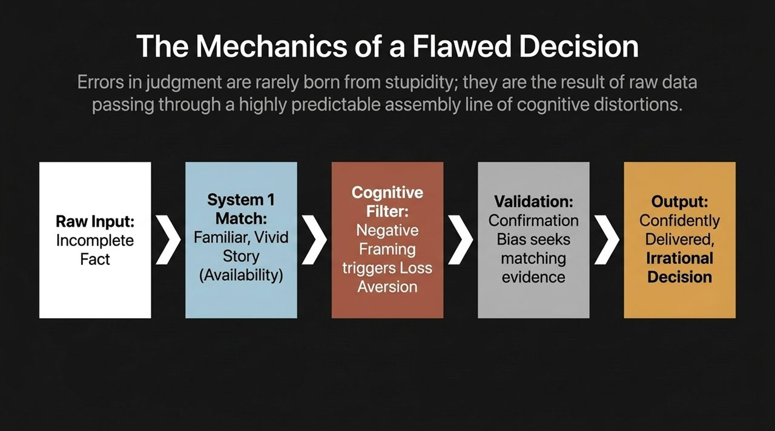
Notes:
The Trap of Outcome Bias:
"In corporate boardrooms and daily life, we tend to judge decisions using a shortcut: if the result was good, we call it a great decision; if the result was bad, we call it a bad decision. In behavioral science, this mistake is called Outcome Bias."
Analyzing the 2x2 Matrix:
"Let's look at the four quadrants on the matrix:
Deserved Success (Good Process + Good Outcome): The ideal scenario where sound analysis yields a great result.
Poetic Justice (Poor Process + Poor Outcome): A reckless choice leads to a bad result.
Unlucky Break (Good Process + Poor Outcome): You did all the right research, managed risk properly, but an unpredictable external event ruined the result. Here, the recommendation is: Stay the course. Do not abandon a sound strategy because of bad luck.
Dumb Luck (Poor Process + Good Outcome): This is the most dangerous quadrant on the grid. Someone takes an uncalculated, foolish risk, gets lucky, and makes a profit."
Why 'Dumb Luck' is Dangerous:
"When 'Dumb Luck' occurs, System 1 claims full credit, declaring: 'I knew I was right!' It dangerously reinforces bad habits, setting the decider up for a catastrophic crash when the luck runs out."
Core Rule:
"You cannot control outcomes; you can only control your process. Evaluate your decisions based strictly on what was known at the time the choice was made."

Slide 12
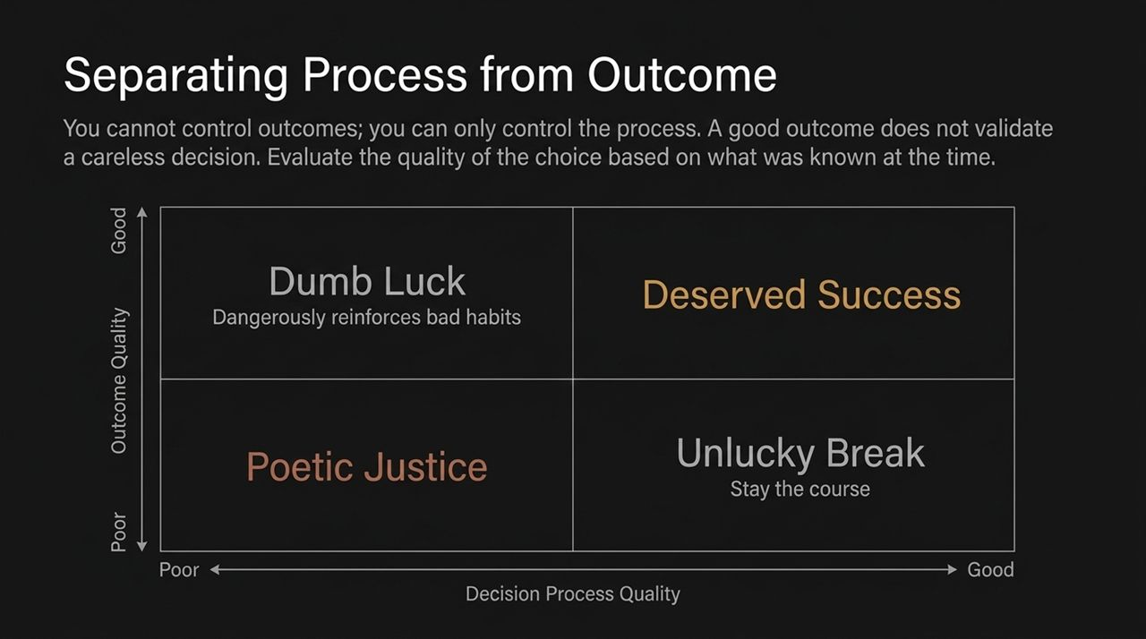
Notes:
Building Circuit Breakers:
"Now that we've mapped the vulnerabilities in our thinking, how do we fix them? You cannot eliminate System 1—nor would you want to. What you can do is design deliberate 'circuit breakers' into high-stakes decision environments."
The 'Pause' Protocol:
"Between a stimulus (a market drop, a tense email, an investment pitch) and your reaction, there is a micro-second window. System 1 wants to jump the gap immediately, driving an Impulse Reaction. The goal of the Pause Protocol is to force a delay."
Forcing System 2 to Boot Up:
"By inserting an explicit Pause Checkpoint, you disrupt the automatic emotional processing. You force the brain to switch gears, giving lazy System 2 the time and cognitive space it needs to boot up, analyze the inputs, and formulate a Deliberate Response. Speed is the friend of bias; deliberate friction is the friend of quality."

Slide 13
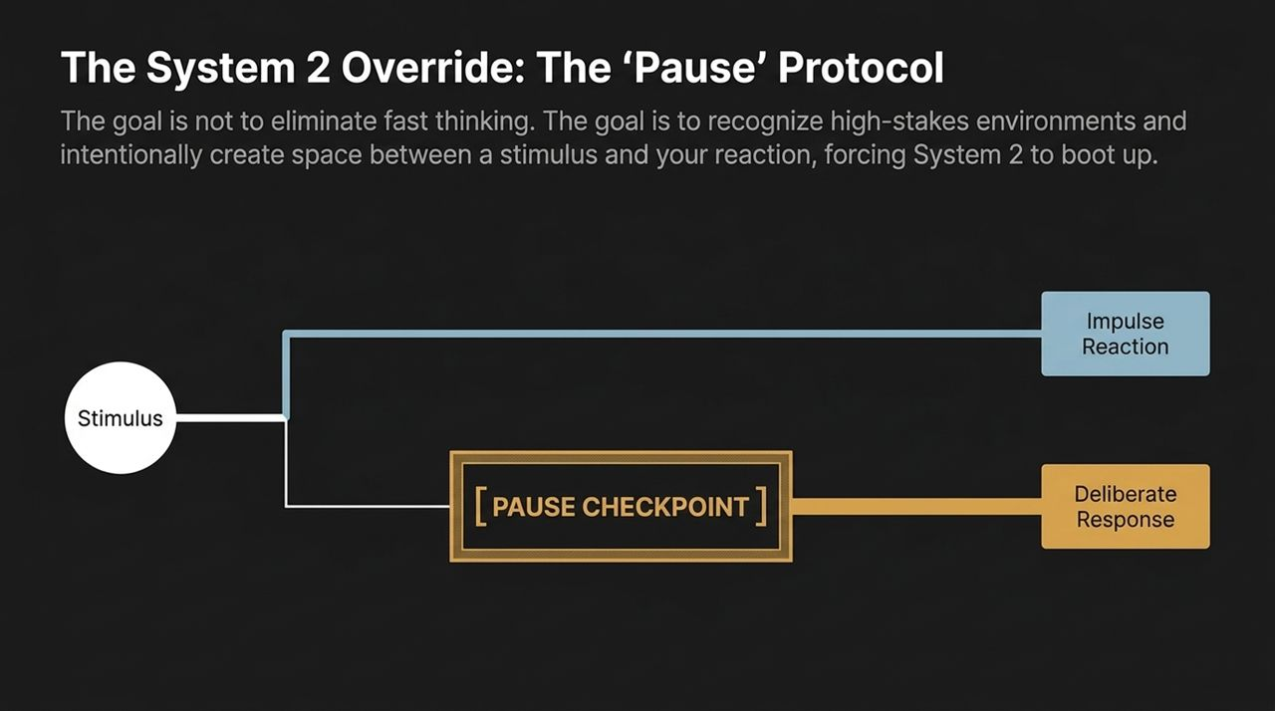
Notes:
Introducing the Checklist:
"Pilots rely on pre-flight checklists not because they are ignorant, but because human memory under pressure is unreliable. Before finalizing any major, irreversible choice, run your initial impression through these five diagnostic friction points."
Items 1 & 2 (Base Rate & Anchor Audit):
"01. The Base Rate Check: Ask yourself: 'Am I reacting to a persuasive, emotional story, or am I looking at broad statistical probabilities?'
02. The Anchor Audit: Trace your numbers back to their origin. 'Where did this initial estimate or target price come from? Is it grounded in objective reality, or was it set by an interested party to anchor my expectations?'"
Items 3 & 4 (Falsification & Sunk Cost Reset):
"03. The Falsification Test: Don't ask 'Why am I right?' Ask: 'What specific piece of data would prove my current thesis completely wrong?' If you can't define what would change your mind, you are operating on dogma, not reason.
04. The Sunk Cost Reset: Mentally wipe the slate clean. 'If we had zero history with this project or employee, and walked in fresh today, would we invest money in them right now?' If the answer is no, step away."
Item 5 (The Hindsight Pre-Mortem):
"05. The Hindsight Pre-Mortem: Assume you are six months in the future, and this project has failed catastrophically. Write down a brief post-mortem detailing why it failed. This simple exercise unlocks critical risk perspectives that team optimism normally silences."
Summary:
"Integrating these five checks into team meetings drastically reduces cognitive errors."

Slide 14
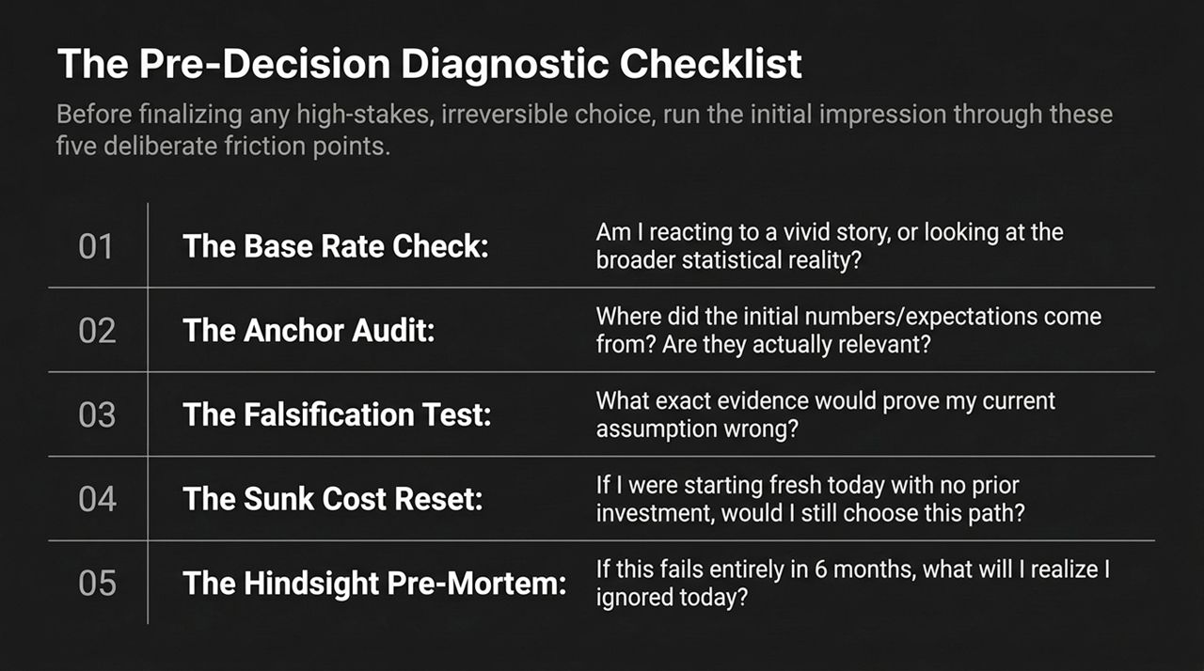
Notes:
Redefining Smart Thinking:
"Many people assume that 'better decision-making' means turning yourself into a cold, hyper-rational computer. It doesn't. True cognitive mastery comes down to a single trait: Intellectual Humility."
Deconstructing Certainty:
"Our minds are biological machines built for survival, framed by shortcuts and prone to self-delusion. When you feel 100% certain about an outcome, recognize that feeling for what it usually is: a biological signal of System 1 coherence, not an objective measure of factual truth. Confidence is not evidence."
Practical Mindset:
"The best thinkers, leaders, and investors aren't the ones who claim to know everything. They are the ones who are careful observers of their own mental processes. They maintain the willingness to slow down, ask hard questions, and change their mind when the facts shift."

Slide 15
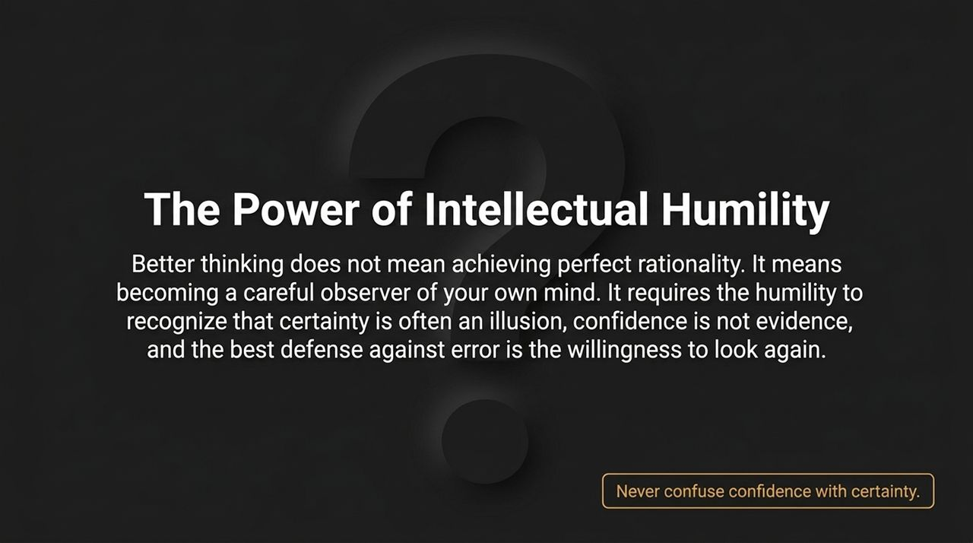
Notes:
Executive Overview:
"This visual executive summary pulls together the entire architecture of choice into a single reference framework."
Recapping the Dual-System Model:
"On the left, we contrast our two cognitive engines:
System 1 (The Cheetah): Fast, effortless, automatic, essential for everyday navigation, but highly vulnerable to emotional bias.
System 2 (The Deliberate Thinker): Analytical, structured, capable of solving complex problems, but lazy and energy-intensive."
Recapping Pitfalls & Strategies:
"In the center, we highlight the primary cognitive landmines: Loss Aversion, Anchoring Effect, and Framing Effects.
On the right are our core actionable defenses:
Create a Strategic Pause: Slow down high-stakes choices to let System 2 engage.
Evaluate Process over Outcome: Judge decisions based on analytical rigor, not luck.
Ask 'What if I'm wrong?': Actively seek out disconfirming evidence."
Conclusion & Final Word:
"When you master the interplay between fast and slow thinking, you stop being a passenger to your mind’s automatic patterns and become the deliberate architect of your own choices. Thank you."

Slide 16
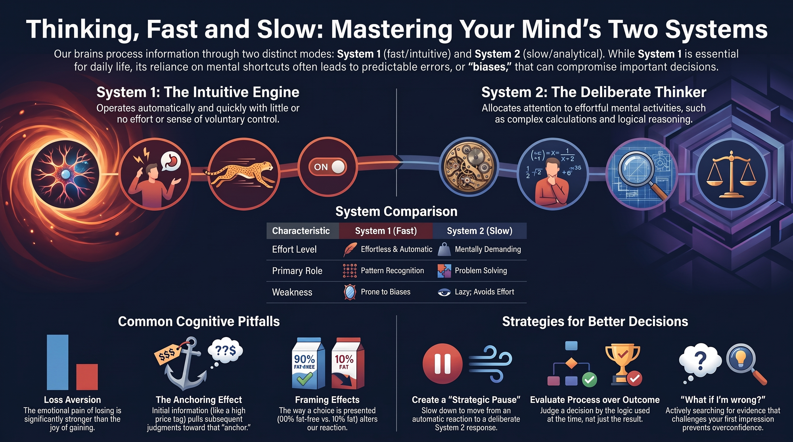
Notes:
https://www.youtube.com/watch?v=rlYXYCVOE_c

